Slide 1
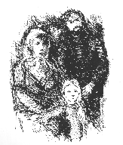
Historical population register 1801-1964
Guelph Conference on Record Linkage
June 2010
(1700 – 2010)
Gunnar Thorvaldsen
Registreringssentral for historiske data

Slide 2
Characteristics of a population registry
It is longitudinal in the sense that it maintains a continuously updated overview of the population in an administrative geographic area.
Records about migrants are linked together when they move inside the administrative area, ideally also when they cross its administrative borders.
The population registry is often based on census records and reports about vital events, linking these together at the individual level and ideally in addition to record information about migration
The composition of the population and the whereabouts of the individuals are documented more or less continuously.
Modern, contemporary population registries are updated in real time so that migration and vital events are mirrored in the database as they are reported.
The continuous nature of the updating of historical population registers must not be interpreted literally,
There may be underreporting of events, especially of co-habitation, illegal in-migration or short-distance mobility.

Slide 3
Historical nominative data in Norway
Male census Censuses
1660s 1801 1865, 1875, 1890, 1900. 1907(1910, 1920, 1930, 1946, 1950, 1960, 1970, 1980, 1990. 2001
_________|___________________________1_____________________1___________________________________|________________________________________________________________________
| |
Church records (forms) Farm tax lists
Andebu 1623 1812) 1832, 1886
Censuses
Male 1660-, 1701
Numeric 1769, 1815-1855
Nominative, public 1801, 1865, 1875, 1900, 1910
Nominative, restricted 1920-1950
Nominative, restricted, digital 1960-1990

Slide 4
Total number of records, and remaining transcription in censuses and church books 19th to 20th century
 |  | Remaining transcription
 | Records | 1801-1959 | 1801-1910
Census 1801 | 883603 | 0 | 0
1865 | 1701756 | 0 | 0
1875 | 1813424 | 900000 | 900000
1890 | 2000917 | 2000917 | 2000917
1900 | 2240032 | 0 | 0
1910 | 2391782 | 0 | 0
1920 | 2649775 | 2649775
1930 | 2814194 | 2814194
1946 | 3156950 | 3156950
1950 | 3278546 | 3278546
Baptisms 1801-1959 | 7881121 | 7093009 | 5088464
Burials 1801-1959 | 4508279 | 4057451 | 2981562
Weddings 1801-1959 | 2231793 | 2008614 | 909258
Sum | 37552172 | 27149456 | 11070201

Slide 5
Additional sources
- Censuses(1769), 1801, (1815, 1825, 1835), 1865, 1875, 1890, 1900, . . .
Almost complete church register from the mid 18th century
Confirmations
In- and outmigration (from 1812, partial)
- Reports of births, marriages, deaths to Statistics Norway from 1866
- Central birth register from 1916
- Immigration from 1916
- Local population registers from 1905 / complete 1946
Central population register from 1964
- Emigrant protocols from ca 1868

Slide 6
Main partner: The University of Tromsø / Norwegian Historical Data Centre
Other partners
The National and Regional Archives of Norway (Arkivverket) Statistics Norway The University of Oslo
The University of Stavanger Norwegian Computing Center The Norwegian Institute of Local History BSS-database (Busetnadsoge) The Norwegian Institute of Public Health The Demographic Database at Umeå University The Historical Sample of the Netherland The Minnesota Population Center
Local historians and genealogists

Slide 9
Local record linkage projects

Slide 10
Some linkage problems
Representativity of the digitized parishes, first letter name groups etc.
Over- and under-enumeration of vital events and household members, including data entry errors.
Missed links and wrong links.
Population censoring errors.
Study group selection bias (too few migrants etc).
Failure to cover entire life spans (Umeå, Stockholm).
No unique id numbers before the Central Population Register in 1964 (Norway <>Sweden)

Slide 11
0 days: N = 1980 (74 %)

Slide 12
Name standardization
Prof Gulbrand Alhaug, UiTø has standardized the censuses 1801-1900
A. Graphemic level B. Phonemic level C. Lexicographic level
Orthographic variants Linguistic variants
Caroles 5 Karoles 51 Karolus 391
Carolus 107 Karolus 340
Charolus 2
Karoles 46
Karolus 231
5 variants 391 2 variants 391 1 variant 391
Table 1: A three level model of name variants
+ Name standardization algorithms

Slide 13
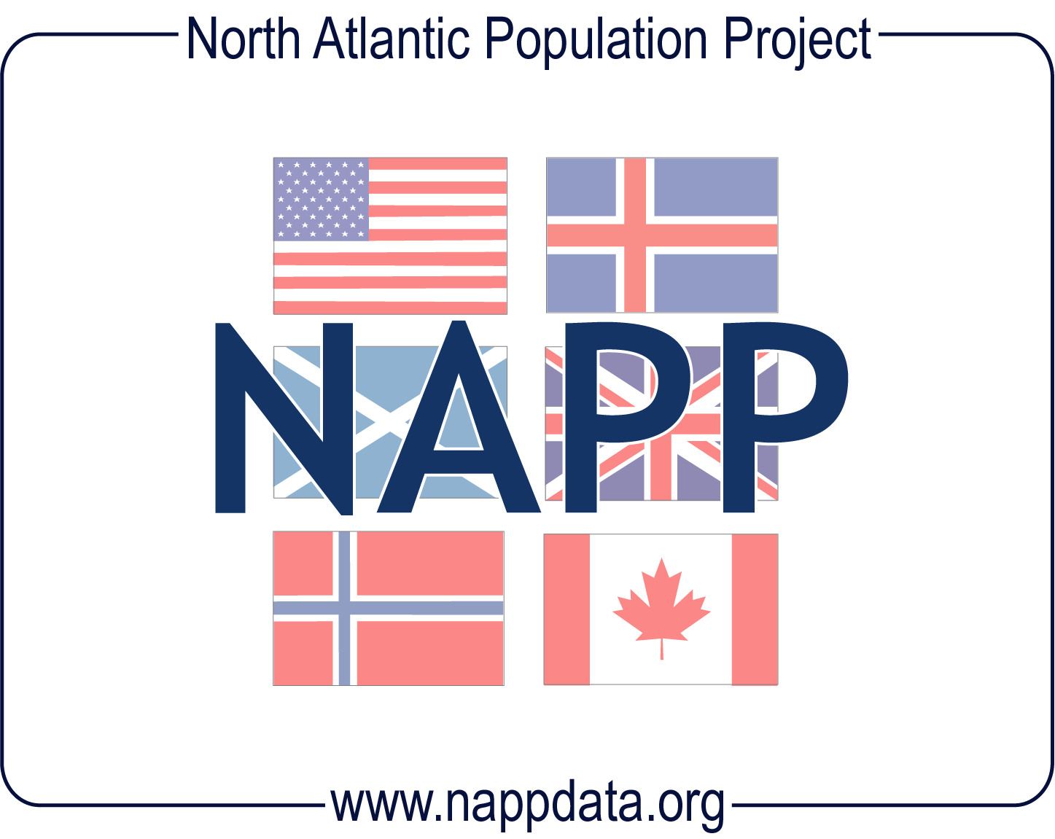
NAPP - North Atlantic Population Project
2001-2005, 2006-2009: Integrated with constructed variables
Britain 1881 29 mill
Canada 1881 4.3 mill
USA 1880 50 mill
Iceland 1703 50000
1880 70000 1901 72000
Norway 1865 1.7 mill
1875 1/3 -> 1/2
1900 2.2 mill
1910 2.4 mill
Sweden 1900 4.9 mill
Denmark, Iceland, Norway 1801
1 + 0,05 + 0,9 mill
Emigration harbour protocols 0,83 mill

Slide 14
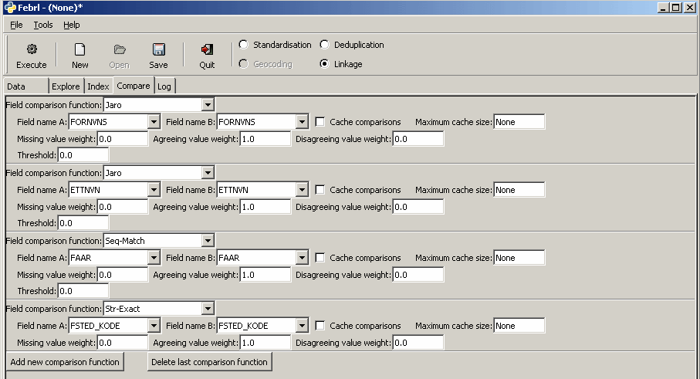
Notes:
FEBRL record linkage software

Slide 16
Community history books with genealogy based on relational database

Slide 18
Sources and tables | Time | N | Linked | Comments
Buried | 1733-1900 | 5519
Baptized | 1733-1900 | 10181
Married (church) | 1733-1900 | 2172 |  | Plus 5 civil marriages
Confirmed | 1736-1900 | 6280 |  | Missing 1780-86
Migrants | 1791-1816 | 29 |  | Only young men
Out-migrants | 1816-1900 | 1428
In-migrants | 1816-1900 | 488
Emigrants (overseas) | 1868-1900 | 860
Stillborn | 1803-1817, 1829-1900 | 267
Introduction after birth | 1750-1787 | 57
Vaccinated (smallpox) | 1814-1867 | 3086
Extra tax | 1762 | 984 | 97,5% | >12 years
Census | 1801 | 1680 | 97,1%
Census | 1865 | 3171 | 94,5% | With 406 out-migrants
Census | 1875 | 3428 | 90,1% | de jure. Only parts of Norway (209)
Census | 1900 | 3722 | 93,4% | de jure. With 654 out-migrants
Census | 1910 | 4019 | 81 % | de jure. To be added outside Rendalen (1021)
Register of landed property | 1723 | 113 |  | Including inland fisheries
Register of landed property | 1838 | 216
Register of landed property | 1886 | 744
Register of landed property | 1903 | 1001
Farm tax | 1802 | 159
Statistical census (farms) | 1825 | 161
Statistical census (farms) | 1845 | 226
Court journals (farms) | 1730-1820 | 2940 |  | From court books
 | 1801-1896 | 9204 |  | From case registers, includes duplicates
Court journals (civil and public cases) | 1763-1797 | 710 |  | not linked
Military rolls | 1821-1854 | 914
Probate registers | 1675-1893 | 747 |  | 335 includes distribution of inheritance
Church
records
Cross-
sectional
records
Farm
records
Other

Slide 19
Population to be contained in population register by period of privacy protection
Population per period | Natives | In-migrants
-> 1801 | 880000 | 5000
1801-1910 | 5088464 | 70000
1911-1930 | 1174656 | 10000
1931-1963 | 1867980 | 89614
1964 -> | 2688790 | 500000
 | 11699890 | 750000

Slide 20
Limited access due to confidentiality in 20th century microdata

Slide 21
Notes:
<http://www.time.com/time/health/article/0,8599,1951968,00.html> Epigenetics

Slide 22
HBR – Historical Population Register Summary
Use: Research, genealogy, teaching
Researchers: Social Scientists, economists, historians
Periods: 1801-1910, 1910-1964 1964 ->
Geographic areas: Nation, regions, municipalities
Problems: Transkription, record linkage, personal privacy

